Slide 1


Triple-S
Final Presentation
For Nutrition Plan Project

Slide 2
Table of content
• Research
• Design
• Back End
• Demo

Slide 3

Research

Slide 4

Research Phase
Surveys
Interviews
Competitive Analysis
User Testing
Notes:
Westarted with multiple brainstorming sessions to actually undersatand what we were tasked with , we then used the double diamond design process model and in the discover phase The main goal of our research was to get to know our target audience (middle aged people) and their preferences more

Slide 5
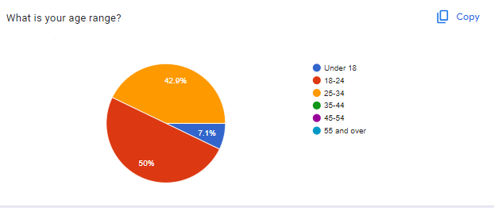
Findings

Slide 6
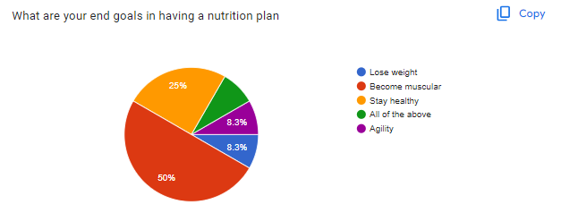
Notes:
We started off our research with a survey to know our demographic more and what features they would expect from our nutrition plan and we got a lot of vital information. We found out that 50% of our users wanted a nutrition plan that'll help them become musculuar

Slide 7
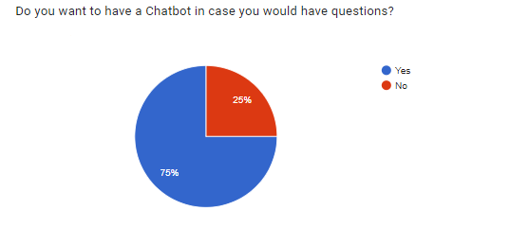
Notes:
We also found out that 75% of our users wanted a chatbot for assistance ,and so we implemented it

Slide 8



Competitive Analysis
Unimeal.com
Eatthismuch.com
Prospre.io

Slide 9
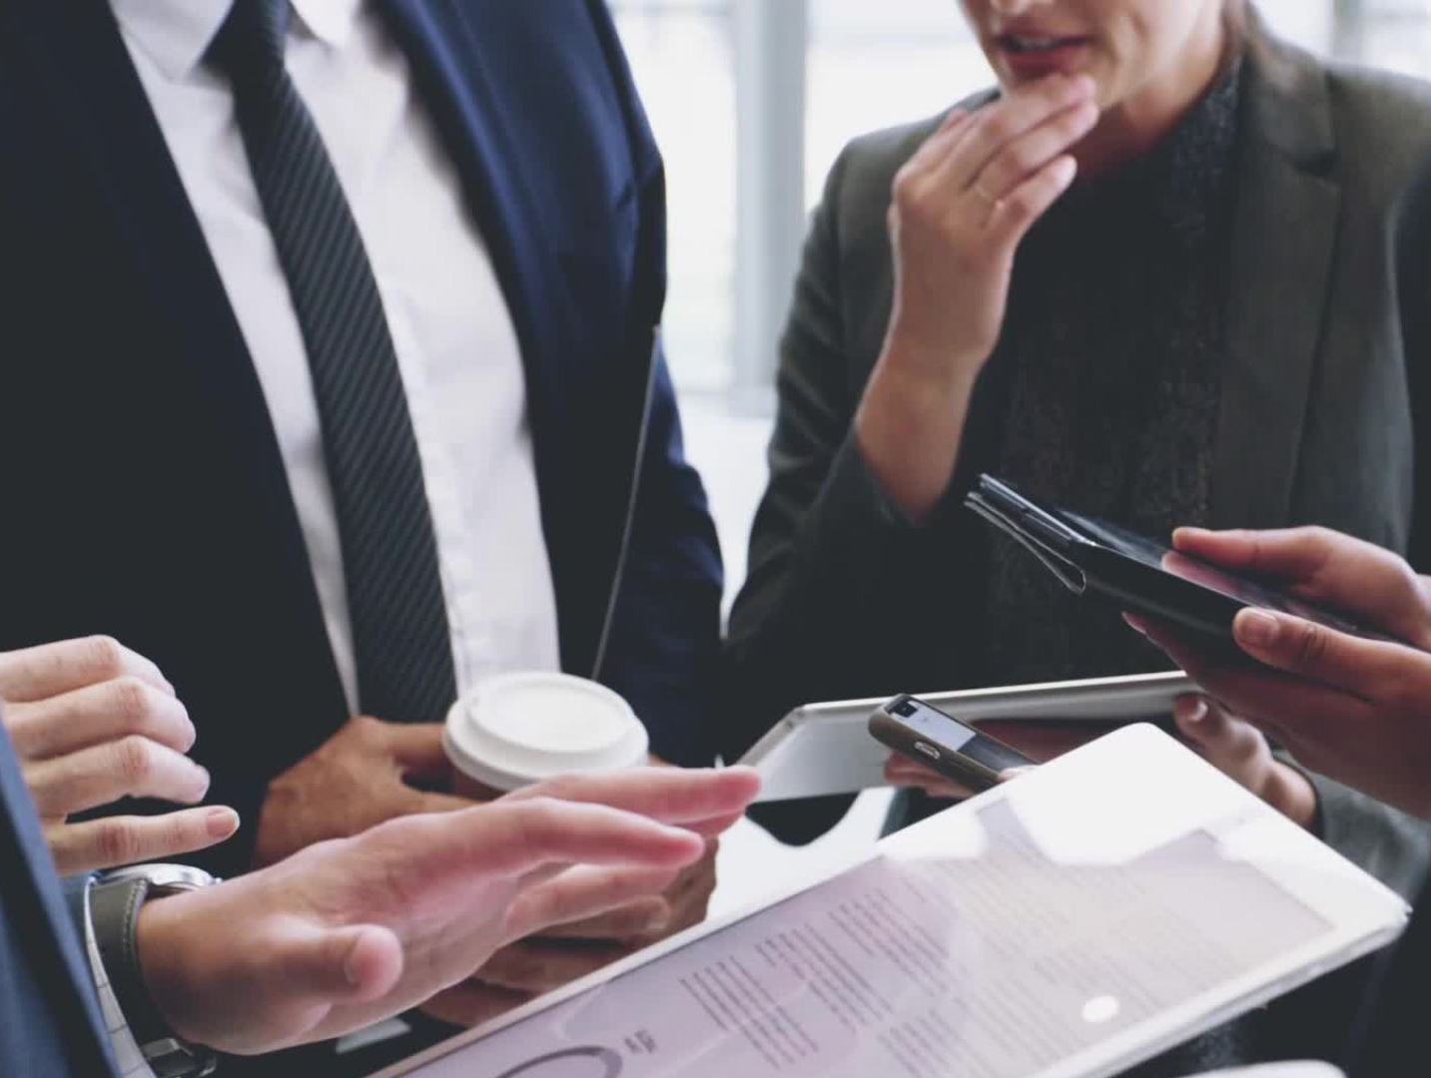
Findings
Users want progress tracking features
Users want plans that are flexible
Users want reminder functionalities
Users want Chatbot for assistance
User want Account system
Notes:
Through our interviews , surveys and user tests , we found out a lot ...in one case the interviewee stated that she didn’t want to have to cook a lot . Users enjoy options for cooking at home or dining out, as well as flexibility

Slide 10

Design

Slide 11
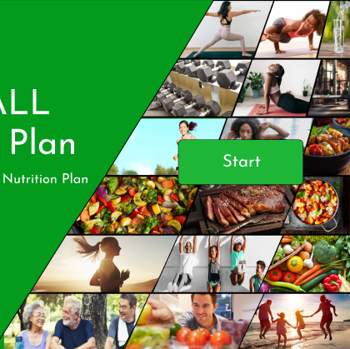
First Iteration Prototype
First Iteration Prototype Link

Slide 12
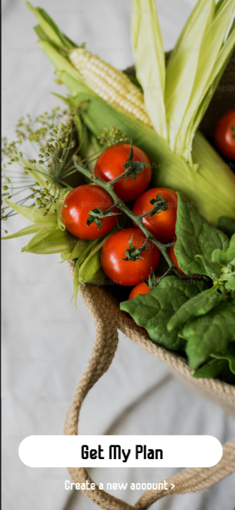
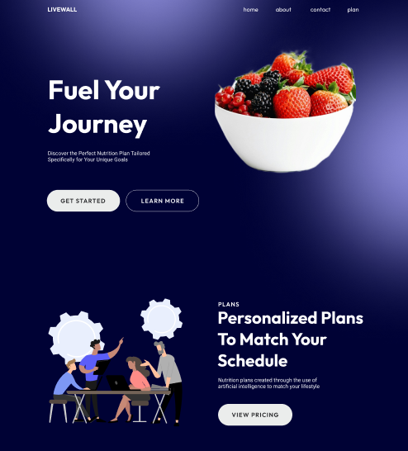
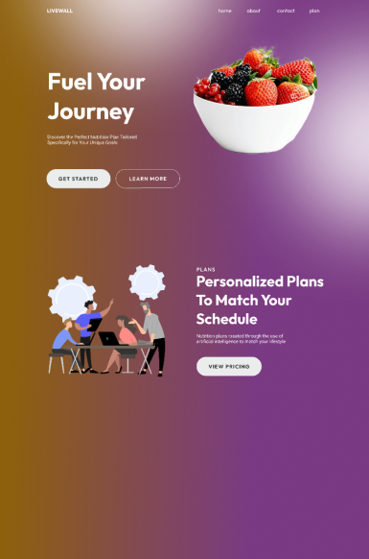
Iterations In-Between

Slide 13
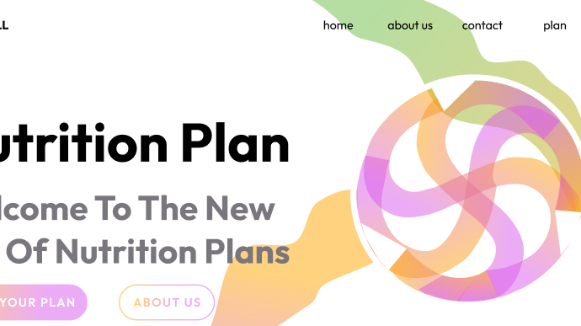
Final Prototype
Final Prototype Link

Slide 14
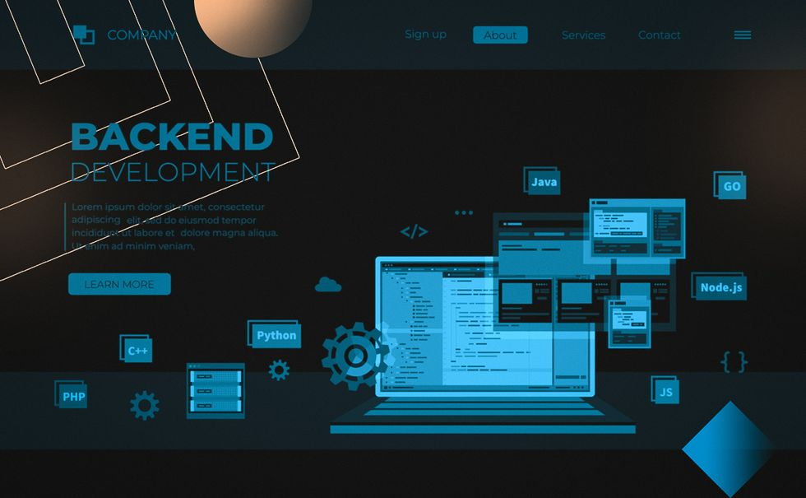
Backend

Slide 15
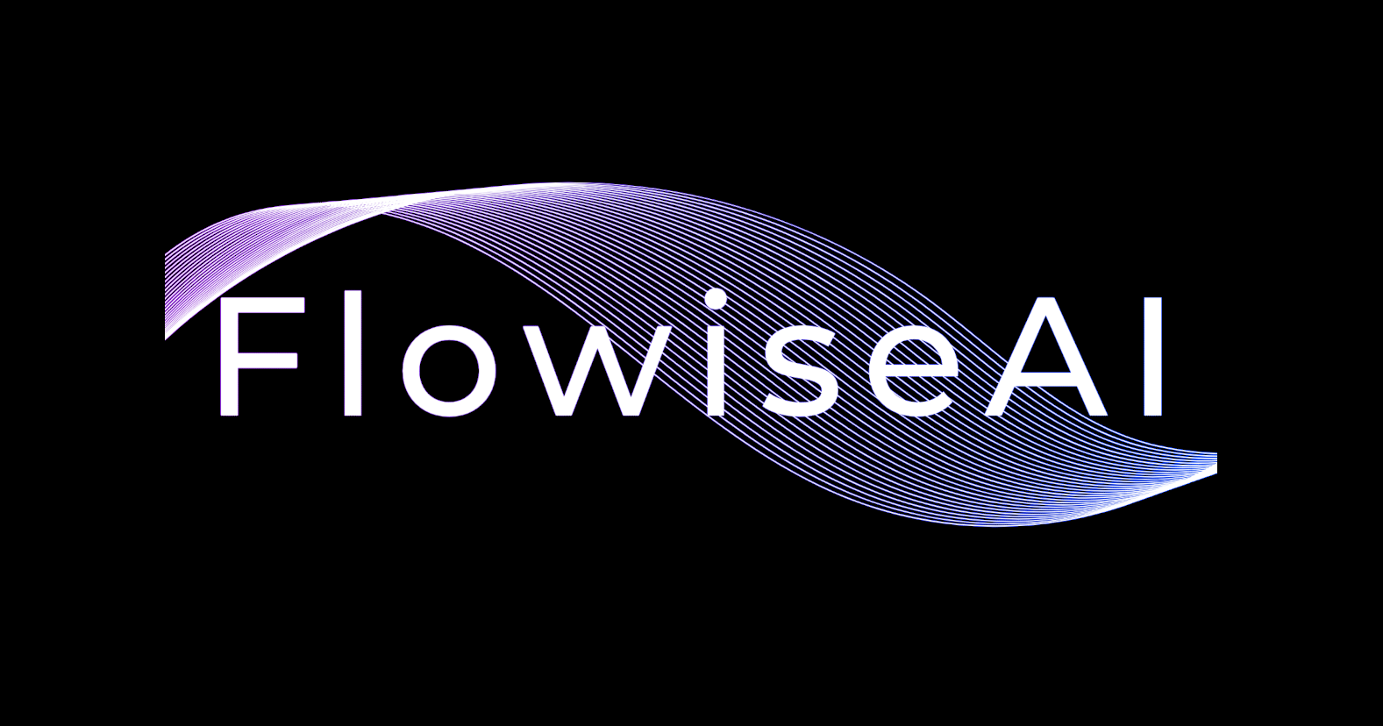


Overview

Slide 16
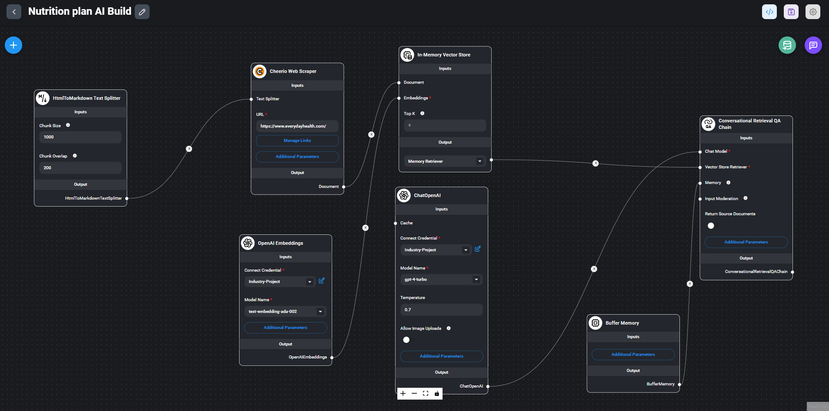
FlowiseAI custom build for the Nutrition Plan AI generator

Slide 17
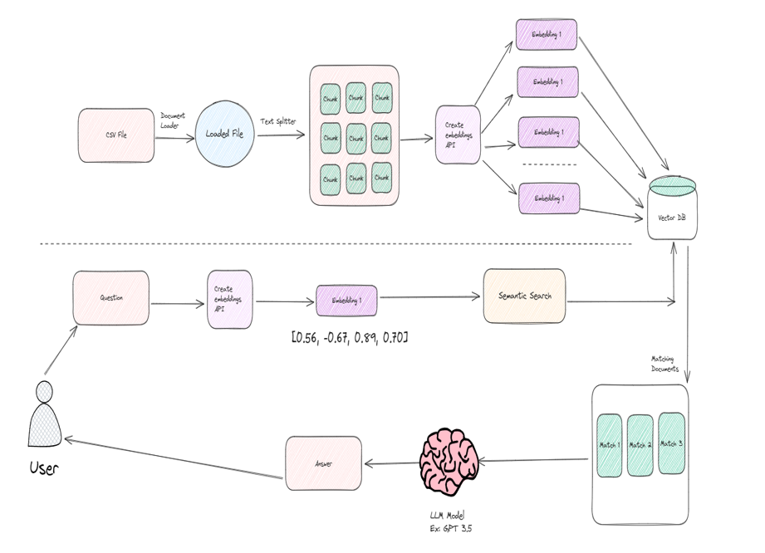

Slide 18
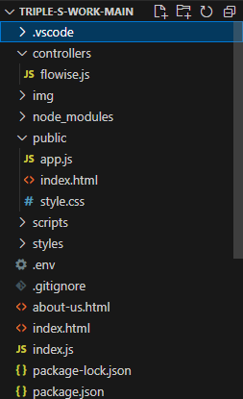
Project Structure
Express Application
Index.Js: Detaches the backend logic from the frontend
flowise.js: Responsible for the request and responds,
prediction function
App.Js: Binds the HTML-Elements to Javascript Variables,
Passes in the responds from the user to the API.
Index.html: The User Interface (Demo)

Slide 19
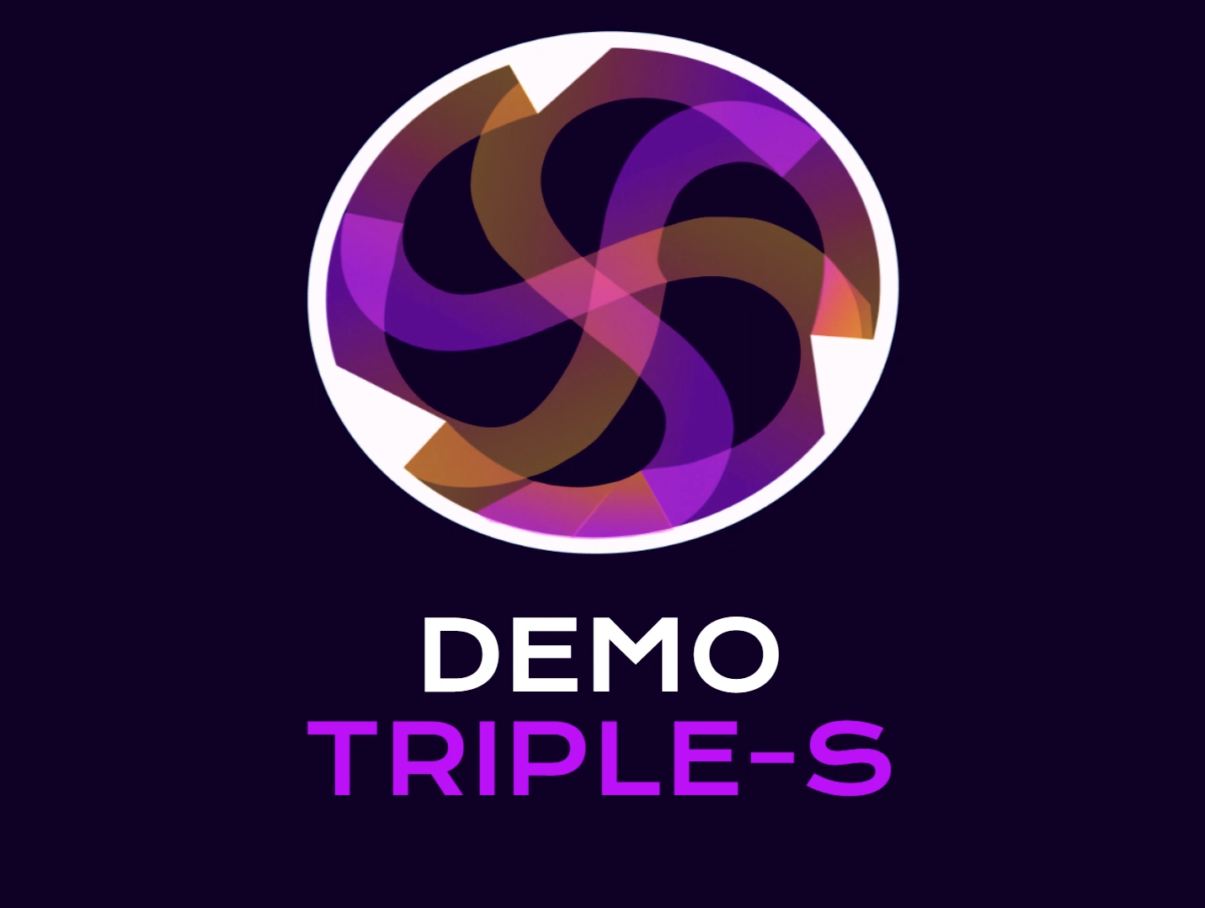
DEMO Nutrition Plan API
https://www.youtube.com/watch?v=0OntpfjBOXU

Slide 20
What went Well
Completed the requirements from client;
Made Functional Website;
Implemented features from our Target Audience needs;
Based our work on the research and feedback we were provided with;

Slide 21

What went Wrong
Communication in Group;
Communication with Client;
Lack of Knowledge

Slide 22

Thank you for your attention

